Slide 1
Objectives for the workshop
An opportunity to understand & discuss Equality, Diversity and Inclusion
To raise awareness of the benefits of a diverse workforce
Explore discrimination law and how it affects us all, in work and life
To reflect on the experiences of some of our colleagues
Review our social media responsibilities
Discuss how we can proactively and positively challenge inappropriate comments and behaviours
To consider our part in ensuring Stagecoach is an inclusive environment

Slide 2
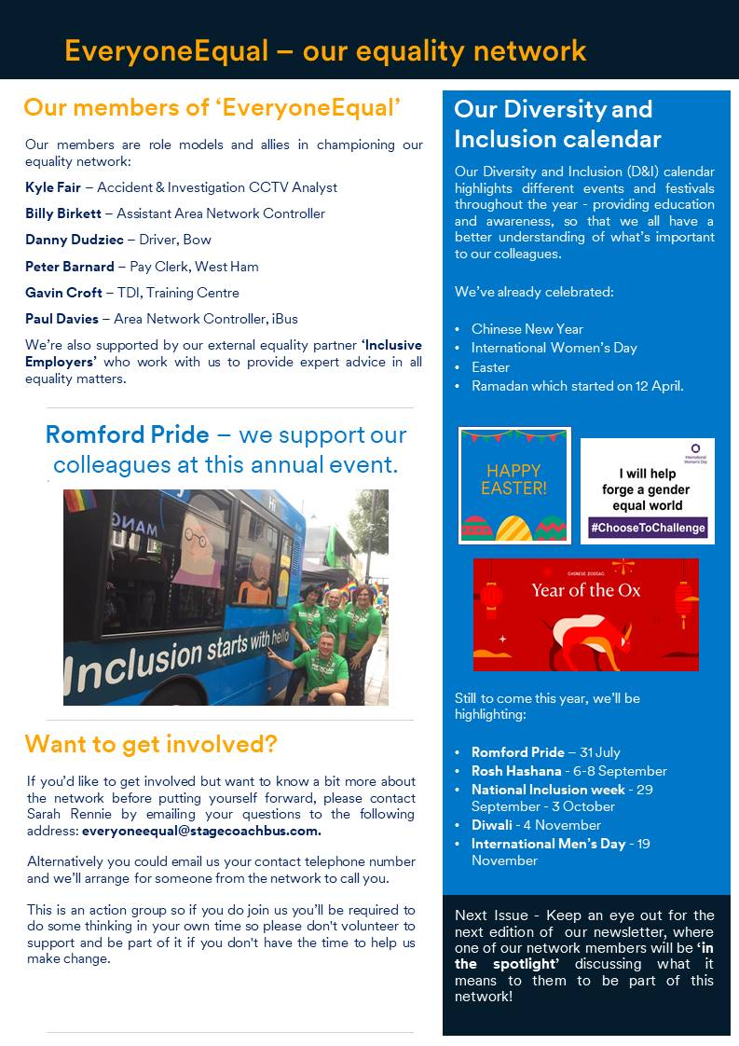
Everyone Equal – our equality network
Everyone Equal is led by volunteers from our London group – they have the freedom to push boundaries, encourage change, support colleagues and be a collective voice. For networks to be a success, passionate volunteers need to come together as one, raise awareness, feed into business decisions and new methods to make businesses stronger.
Members of the network are committed to supporting colleagues and bringing positive change to our business

Slide 3
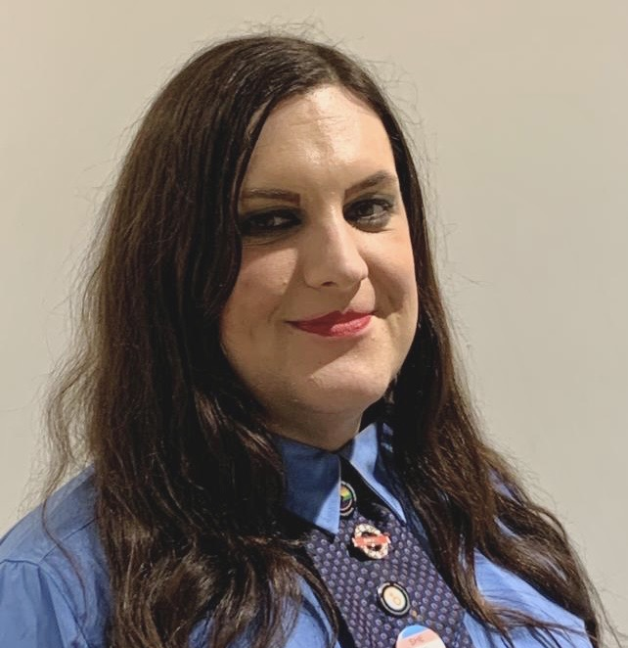
Our people who shared their stories
Jamie-Lee, a Bus Driver shared her story of how mis-gendering has affected her.

Slide 4
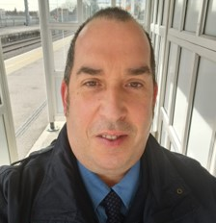
Our people who shared their stories
Daniel, a Bus Driver, shared his story of living with a hidden disability.

Slide 5
Dignity in the workplace posters
Gender wording

Slide 6
Dignity in the workplace posters
Abusive messages

Slide 7
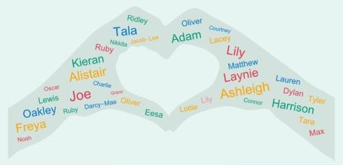
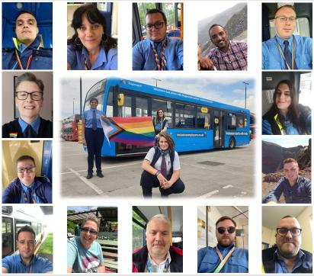
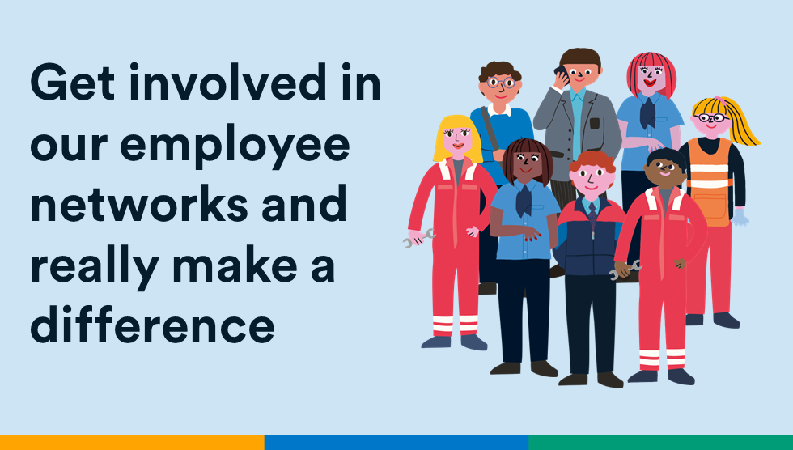
Stagecoach Group
Employee Networks
Parents Network
Multiculture Network
LGBTQ+ Network
Women @ Stagecoach
Veterans Network
Carers Network
Women’s Network

Slide 8
Summary of our discussion today
The difference between Equality, Diversity & Inclusion
The Equality Act 2010 & the 9 Protected Characteristics
Barriers to inclusion & where we might see a lack of inclusion
We heard from colleagues lived experiences
We had a quiz!
Hidden disabilities, the impact on people & business, and the importance of reasonable adjustment
The business case for being an inclusive employer
Pronouns and their importance in an inclusive environment
When is banter not banter?
Impact versus Intent, and our responsibilities when using social media
Inclusive communication and its importance to the success of Stagecoach
Great examples of inclusion in your team or department
Everyone Equal network and the Stagecoach employee networks
Empathy and your role in supporting equality, diversity and inclusion in Stagecoach

Slide 9
Equality, Diversity and Inclusion Training – Workshop Evaluation Feedback
My understanding of equality, diversity and inclusion has improved through attending this training.
(90 Respondents)

Slide 10
Equality, Diversity and Inclusion Training – Workshop Evaluation Feedback
The trainer kept me interested throughout the training.
(90 Respondents)
Questions were encouraged by the trainer.
The trainer communicated the subject matter in a clear and engaging way.

Slide 11
Equality, Diversity and Inclusion Training – Workshop Evaluation Feedback
What can we improve for future training sessions?
(90 Respondents)

