Slide 1
Economics of Bus Operation in a Post-Covid World
13 September 2022
Chris Cheek BA FCILT MCIM

Slide 2
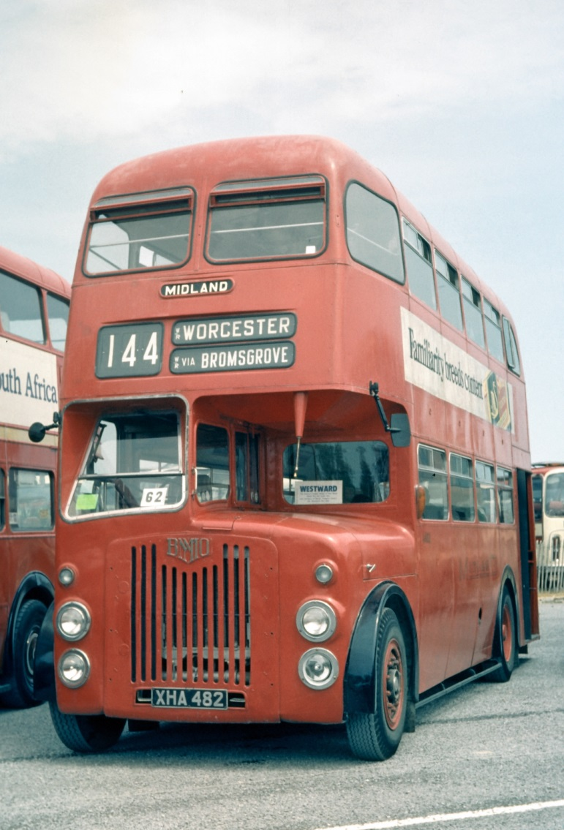
My Background
Joined the National Bus Company 1972
1972-87: Line Management
Bus & Coach Operations
Advertising & Marketing
Incoming Tourism
Sightseeing
Since 1987
Consultancy, analysis and writing
The TAS Partnership (1994-2016)
UK Bus Awards (since 1996)
Passenger Transport Monitor (since 1991)
Analysis and commentary (reports and trade press)

Slide 3
Writing and Publishing
Passenger Transport Monitor
Online since 2009, incorporating
Bus Industry Monitor
Rapid Transit Monitor
Rail Industry Monitor
Other reports and commentaries
Understanding Buses (2nd edition 2021)
5 LGBT novels + 1 in progress

Slide 4
My Agenda Today
What’s changed?
What do the changes mean for the industry?
The challenges that arise
What solutions are available

Slide 5
Changes driven by Covid
Falls in demand
Huge drops during lockdowns
Failed to recover fully since
Currently 85% for paying passengers
But only 67% for concessions
Economic and social change
Increase in WFH
Decline in Retail
Labour shortages
Increased inflation

Slide 6
Employment Changes
Increase in working from home*
Homeworking increased from 267k (10%) to 808k (30%) between 2019 and 2022
WFH one day or more a week 212k (12.1%) in Q1 2022
Bus commuters fell from 9.5% of the workforce to 7.7% between 2019 and 2020
20% fewer workers using the bus
* - Statistics from the ONS Labour Force Surveys

Slide 7
Driver Shortages
Increased competition from freight sector
Reduced net migration since Brexit referendum
30,000 more economically inactive than in summer 2019
Poor financial performance limits ability to increase wages, causing industrial action

Slide 8
Inflation and the Cost Explosion
Energy price explosion
Record price for diesel, now at 182p per litre, +38% since 2019
Electricity +46% Q1 2019 to Q1 2022
Further increases since
Drives other input prices as well as direct operator costs
Labour cost increases as the industry competes for staff

Slide 9
Other Consequences
Higher interest rates with more increases to come
Changes to the industry’s risk profile, post-Covid and with delayed recovery
Both acting to push up the cost of capital
Depresses investment
Increases profit targets

Slide 10
What do the changes mean?
Fewer passengers
commuting and retail trips unlikely to return
Lower revenue
Higher costs of operation
Increased cost of capital
Loss of network viability

Slide 11
The Challenges Ahead
Market recovery
Winning passengers back
Short-term sustainability
Getting back to viability
The Zero Emissions Path
Funding the investment
Getting whole life costs down
Modal Shift
Meeting the net zero targets

Slide 12
Winning Passengers Back
People, especially elderly people, need reassurance that bus travel is safe
Services need to be reliable
Urgent need to solve the driver problem
Congestion still a huge issue
Need to give people new reasons to travel

Slide 13
Network Sustainability
Poses very difficult dilemmas
Overriding need to maintain viability to stay in business
In the absence of ongoing public support, this means
Service reductions
Increased fares

Slide 14
Financial Performance
Operators need to generate a surplus of income over expenditure
Surplus needs to provide for
Renewal of assets
Building reserves to survive bad times
Business improvement & expansion
Funding the cost of capital
Making debt repayments as they fall due
This applies whoever owns the business

Slide 15
How much profit?
Driven by resources required
Buses
Depot
Other Equipment
Money to fund these = capital
borrowed from shareholders and lenders
Borrowing creates obligations
Pay interest
Reward shareholders (dividends)
= cost of capital

Slide 16
Calculating Target Profit & Revenue

Slide 17
Our Model
A 200 vehicle company in ‘shire’, ‘urban’ and London environments
Model shows how targets for profit and revenue are driven by the obligations
Margins needed = 7.5% to 8.5%
Increase by 0.7% for every 1% increase in interest rates

Slide 18
How operating profit is spent
Meet interest charges on loans/leases
Repay loans
Pay tax
Pay a dividend
Transfer funds to reserves
Based on a ‘Shire’ company with 200 buses in 2019

Slide 19
Operating Profit Margins in Scotland
Source: Bus Industry Monitor database

Slide 20
What drives bus costs?
Principal driver of costs = time
Time taken on a route determines
How many buses
How many drivers
Speed therefore crucial
Small variations can make a big difference

Slide 21
Calculating Operating Costs

Slide 22
Quick Example
Local bus service with 11.5 km round trip, every 10 minutes, 14 hours a day, and an average fare £1.32
Item | @ 12 mph | @ 10.3 mph | @ 9.5 mph
Time taken | 37.5 | 43.7 | 47.4
Buses required | 4 | 5 | 6
Driver hours/day | 81 | 104 | 121
TOTAL COSTS (£000) | 1,061 | 1,284 | 1,507
Profit required (£000) | 86 | 104 | 122
TARGET REVENUE (£000) | 1,147 | 1,388 | 1,629
Passengers needed (000s) | 869 | 1,052 | 1,234

Slide 23
Current Situation
Anecdotally, speeds have been falling
Limited statistical evidence
Stats show staff productivity falling by 26% since 2005
Changes in service levels will also contribute (especially in 2020)
Bus Industry Monitor analysis of Annual Bus Statistics, Department for Transport.

Slide 24
Industry Cost Proportions
Drivers are the principal item @ 42%
Overall, labour accounts for just over 60%
Fixed Costs are 22%
Balance is cost of materials
fuel oil & tyres
spare parts
Based on 2019 accounts and CPT Cost Index

Slide 25
Regulatory and Ownership Change
‘Franchising’
Networks planned by local authorities then let by competitive tender
Authorities also set fare, and determine ticket types
Give authorities more control over their local buses
‘London style’ operation

Slide 26
Franchising
Franchising would not
Stop
rising costs
Increased congestion
Avoid
The need for operator profits
The tendency for fares to rise above inflation
Franchising would
Transfer risk to the public sector
Be expensive to administer
Cost public money we don’t have
Reduce flexibility and innovation
Guarantee operator profits, if necessary at taxpayers’ expense
Break the link between operator and customer

Slide 27
Municipal Operation
Local authority ownership of bus companies has endured in some places, notably Edinburgh
Also hugely successful in Reading and Nottingham
Owning councils do require a dividend where possible
But success is not guaranteed…
Even Lothian lost money in 2019
Council-owned bus companies
51 in 1986 in GB
8 remain
6 were forced to cease trading
37 sold by their authorities
Financial difficulties
Problems raising funds for investment
Capital employed better used elsewhere

Slide 28
New Municipal Companies
Three routes to council ownership
Set up new company to compete with existing operators
Raise capital to acquire an existing local bus company
Compulsory acquisition of all or part of an existing operation
Each would require:
Initial funding to acquire assets
Working capital
Funds for future investment
A business case showing how the business would be viable
An annual surplus to meet borrowing costs and repay debt (i.e. make a profit)

Slide 29
Modal Shift – riding to the rescue?
Scottish Govt commitment to cut car km by 20% by 2030
9bn down from 45bn km
12.5bn down from 63bn pass km
Public transport use pre-Covid:
2.6bn by bus
3.4bn by rail
Each 1% switched from car
= + 23.7% bus demand
= + 18.6% rail demand
Thus, even a 5% switch from car to bus would be enough to double previous bus demand
Back to 1980 levels
BUT
49% of car mileage is rural
18% on motorways
Only 33% in urban areas
Makes a 20% cut very difficult

Slide 30
Is Modal Shift going to happen?
YES
The targets are enshrined in law at UK and Scottish level
Governments remain committed to Net Zero policies of which these targets are an essential part
Increasing public pressure, will get stronger as weather events etc get more extreme
Especially important to young people
NO
No sign of detailed measures needed to deliver the policies
Little sign of public understanding of the changes in lifestyle needed
Continued portrayal of measures as “war on the motorist”
Government by tabloid – the fuel tax rebellion still looms large

Slide 31
Success is still possible
Quality and innovation can drive patronage growth
Examples throughout the country
Public policy has a vital role
Consistently pro-public transport
Parking policy
Priority measures
Good infrastructure
Faster more reliable journey times
Stability in funding
Partnerships with operators

Slide 32
Any Questions?
www.facebook.com/passtransuk/

